Slide 1
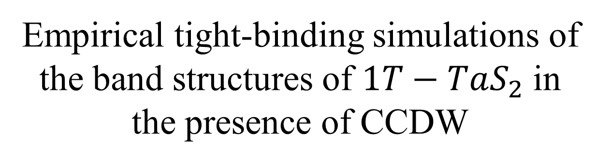
Empirical tight-binding simulations of the band structures of $1T−TaS_{2}$ in the presence of CCDW

Slide 2
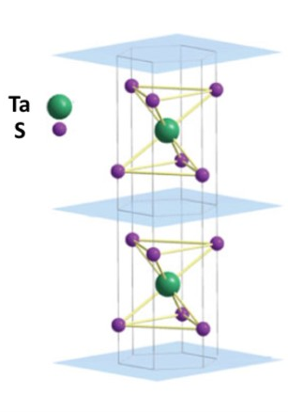
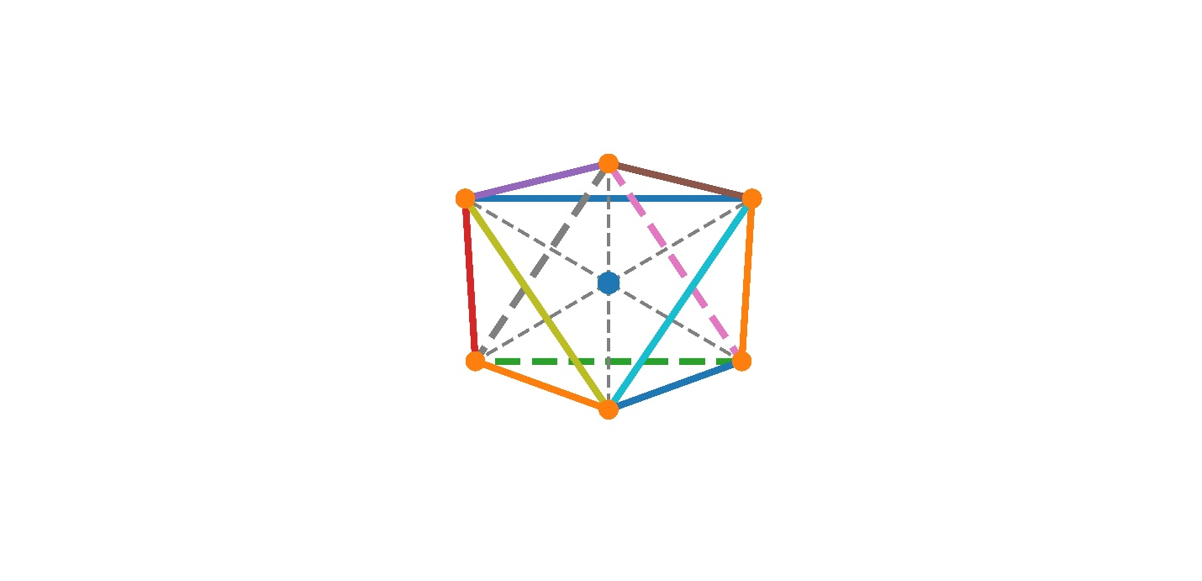
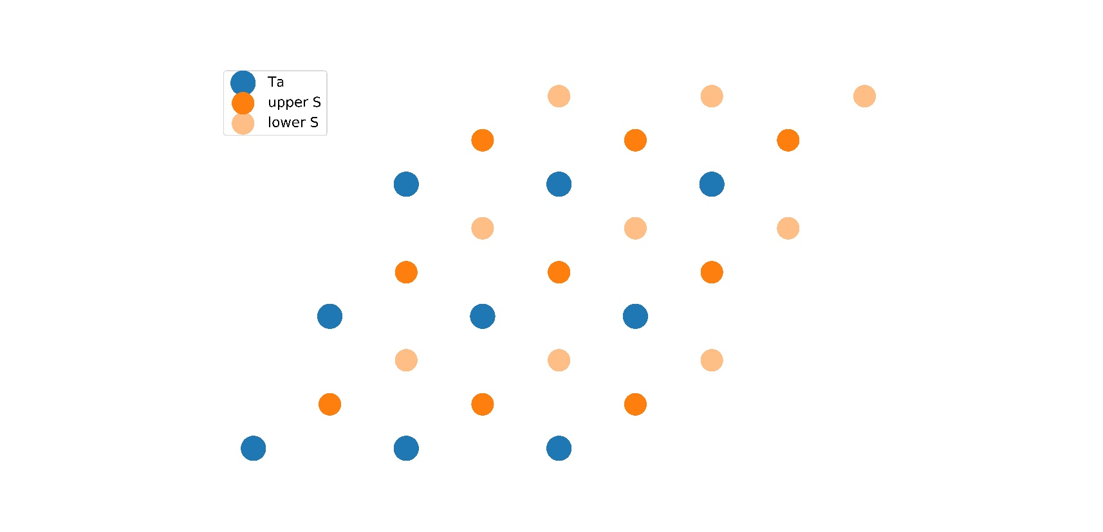
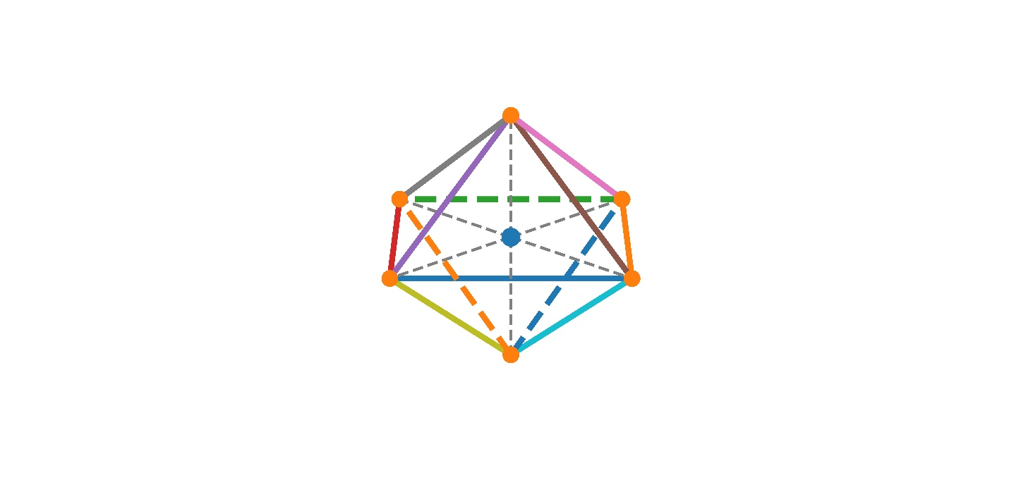
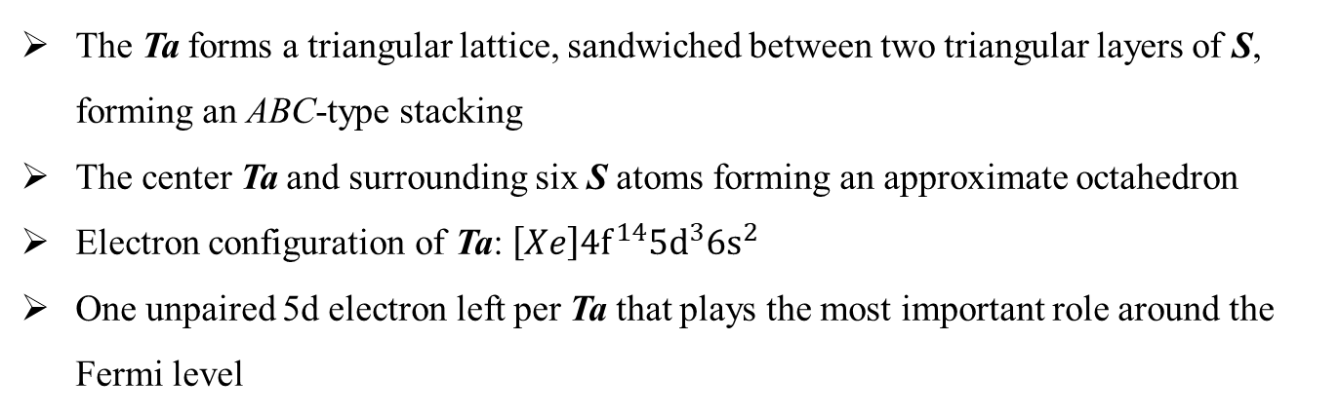
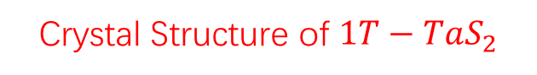
Crystal Structure of $1T−TaS_{2}$
The Ta forms a triangular lattice, sandwiched between two triangular layers of S, forming an ABC-type stacking
The center Ta and surrounding six S atoms forming an approximate octahedron
Electron configuration of Ta: $\left[Xe\right]4f^{14}5d^{3}6s^{2}$
One unpaired 5d electron left per Ta that plays the most important role around the Fermi level

Slide 3
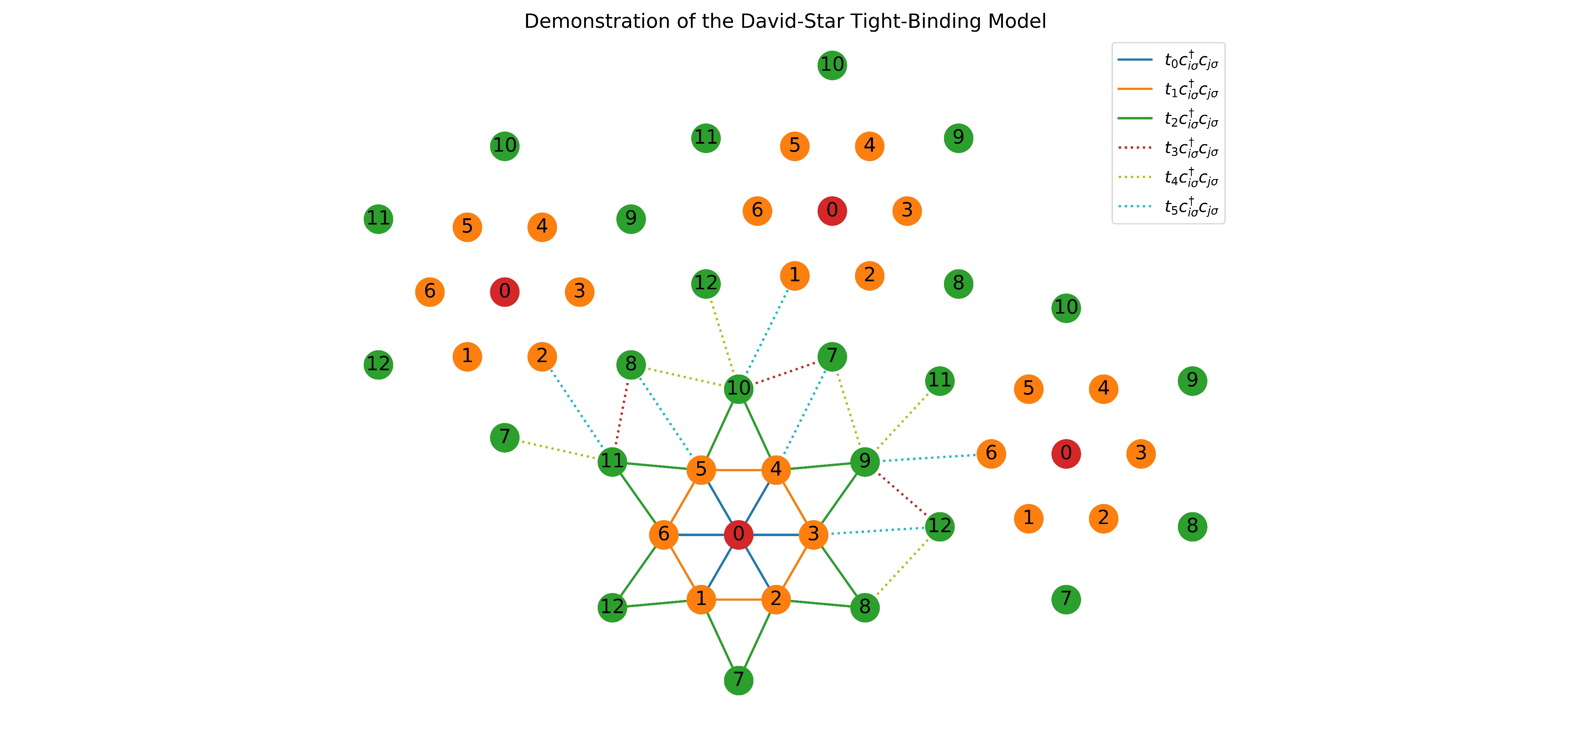
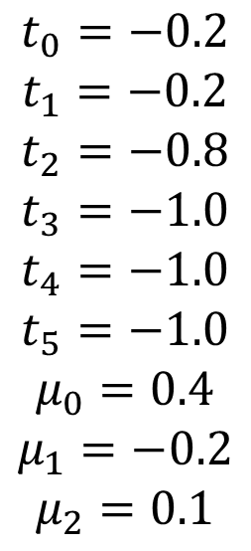
Tight-Binding Model
$$t_{0}=−0.2$$
$$t_{1}=−0.2$$
$$t_{2}=−0.8$$
$$t_{3}=−1.0$$
$$t_{4}=−1.0$$
$$t_{5}=−1.0$$
$$μ_{0}=0.4$$
$$μ_{1}=−0.2$$
$$μ_{2}=0.1$$

Slide 4
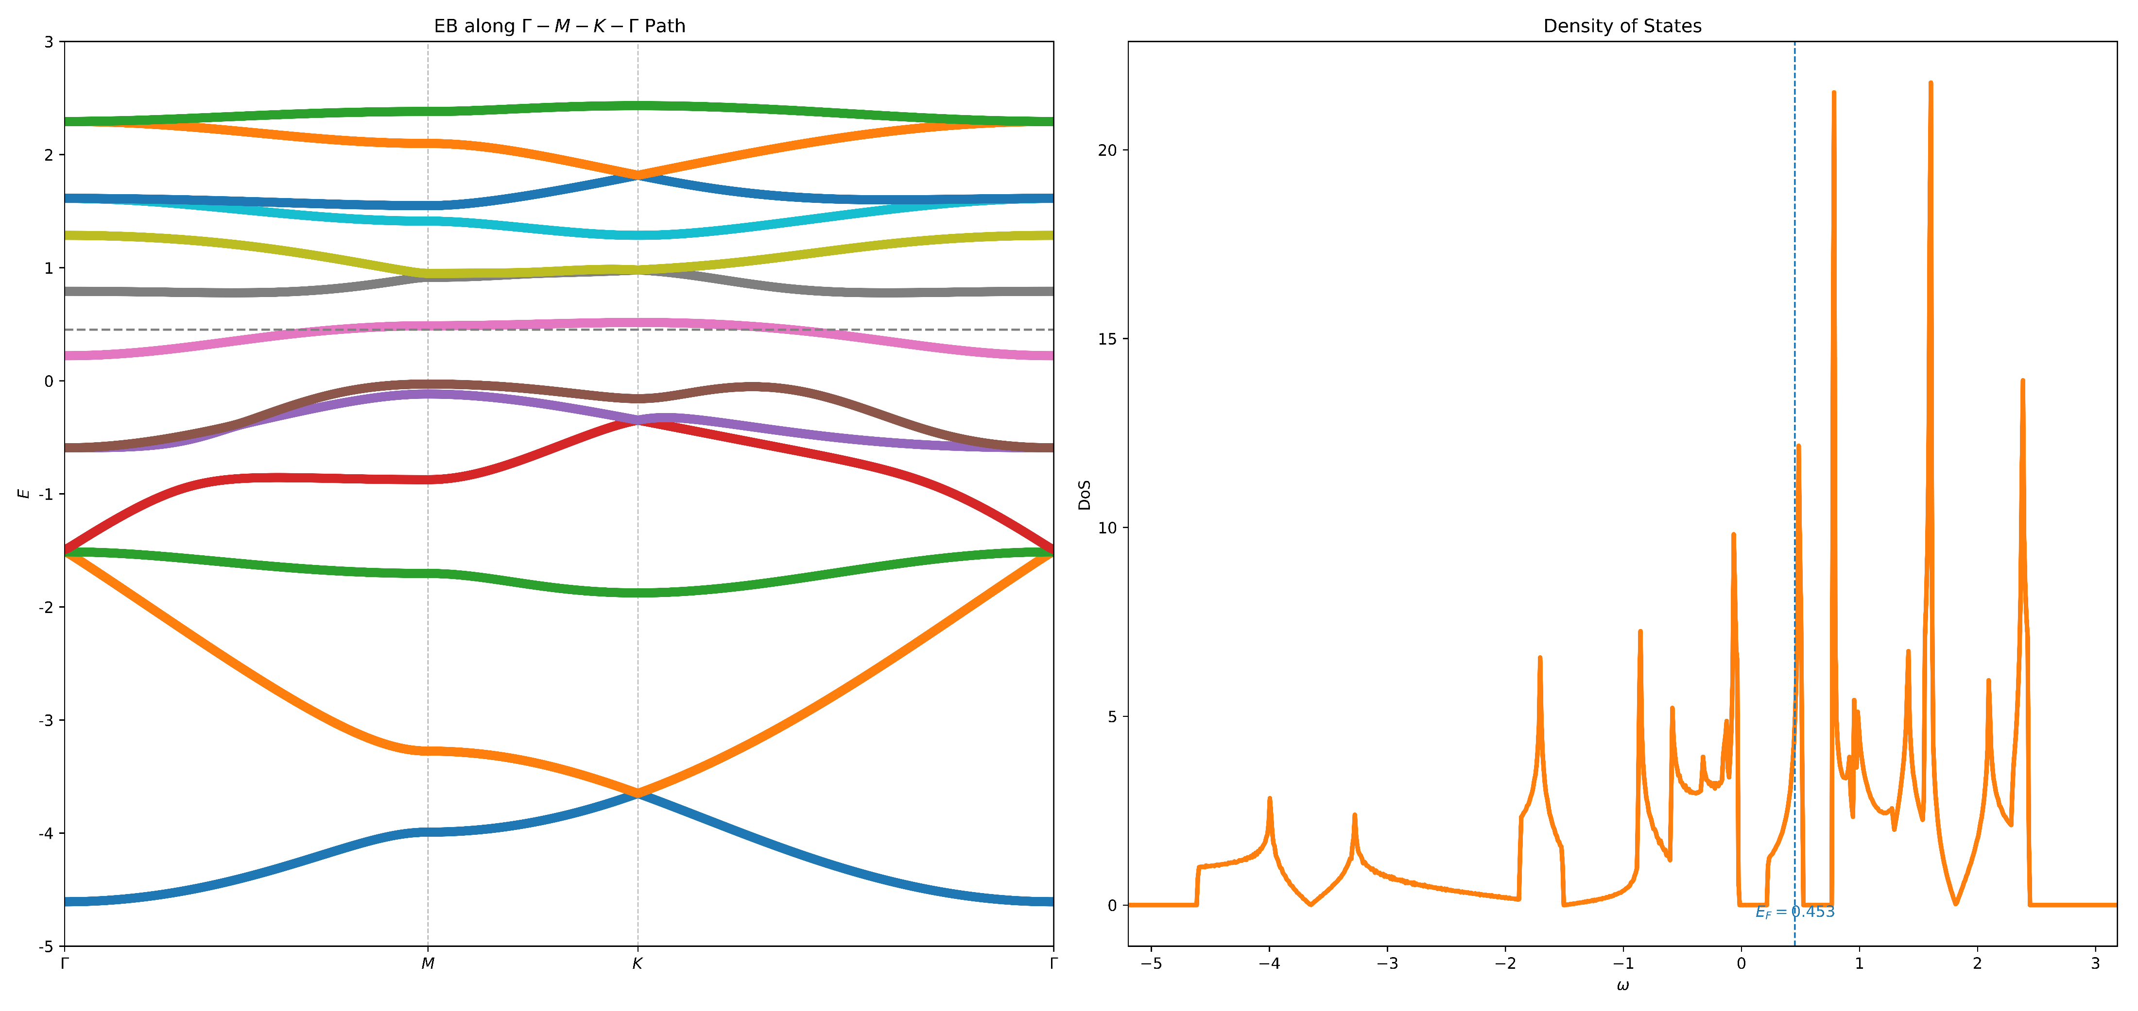
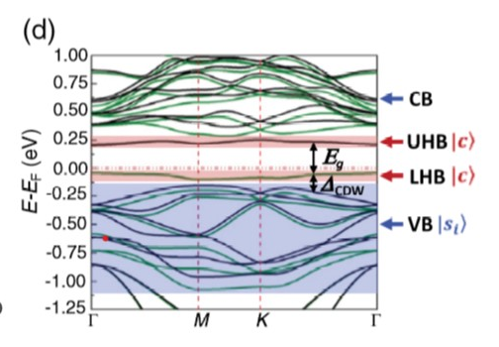
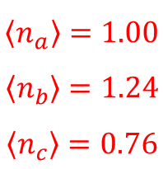
$$\left\langle n_{a}\right\rangle =1.00$$
$$\left\langle n_{b}\right\rangle =1.24$$
$$\left\langle n_{c}\right\rangle =0.76$$

Slide 5
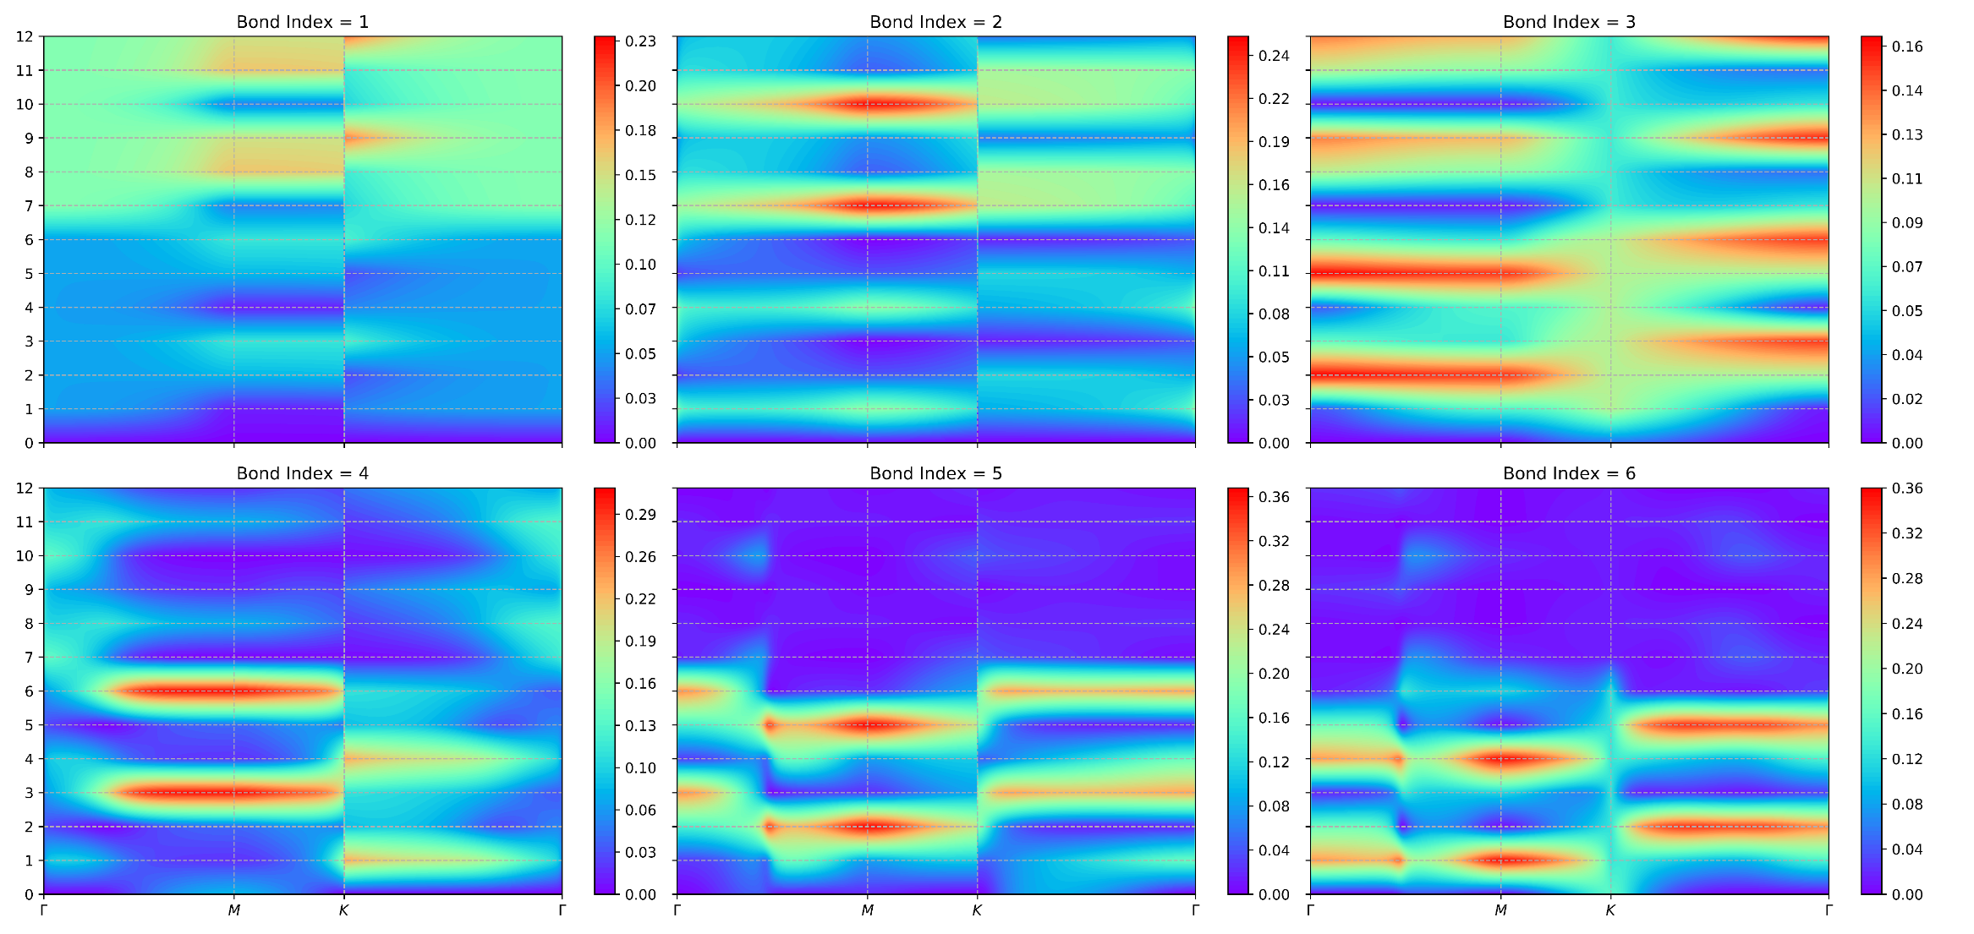
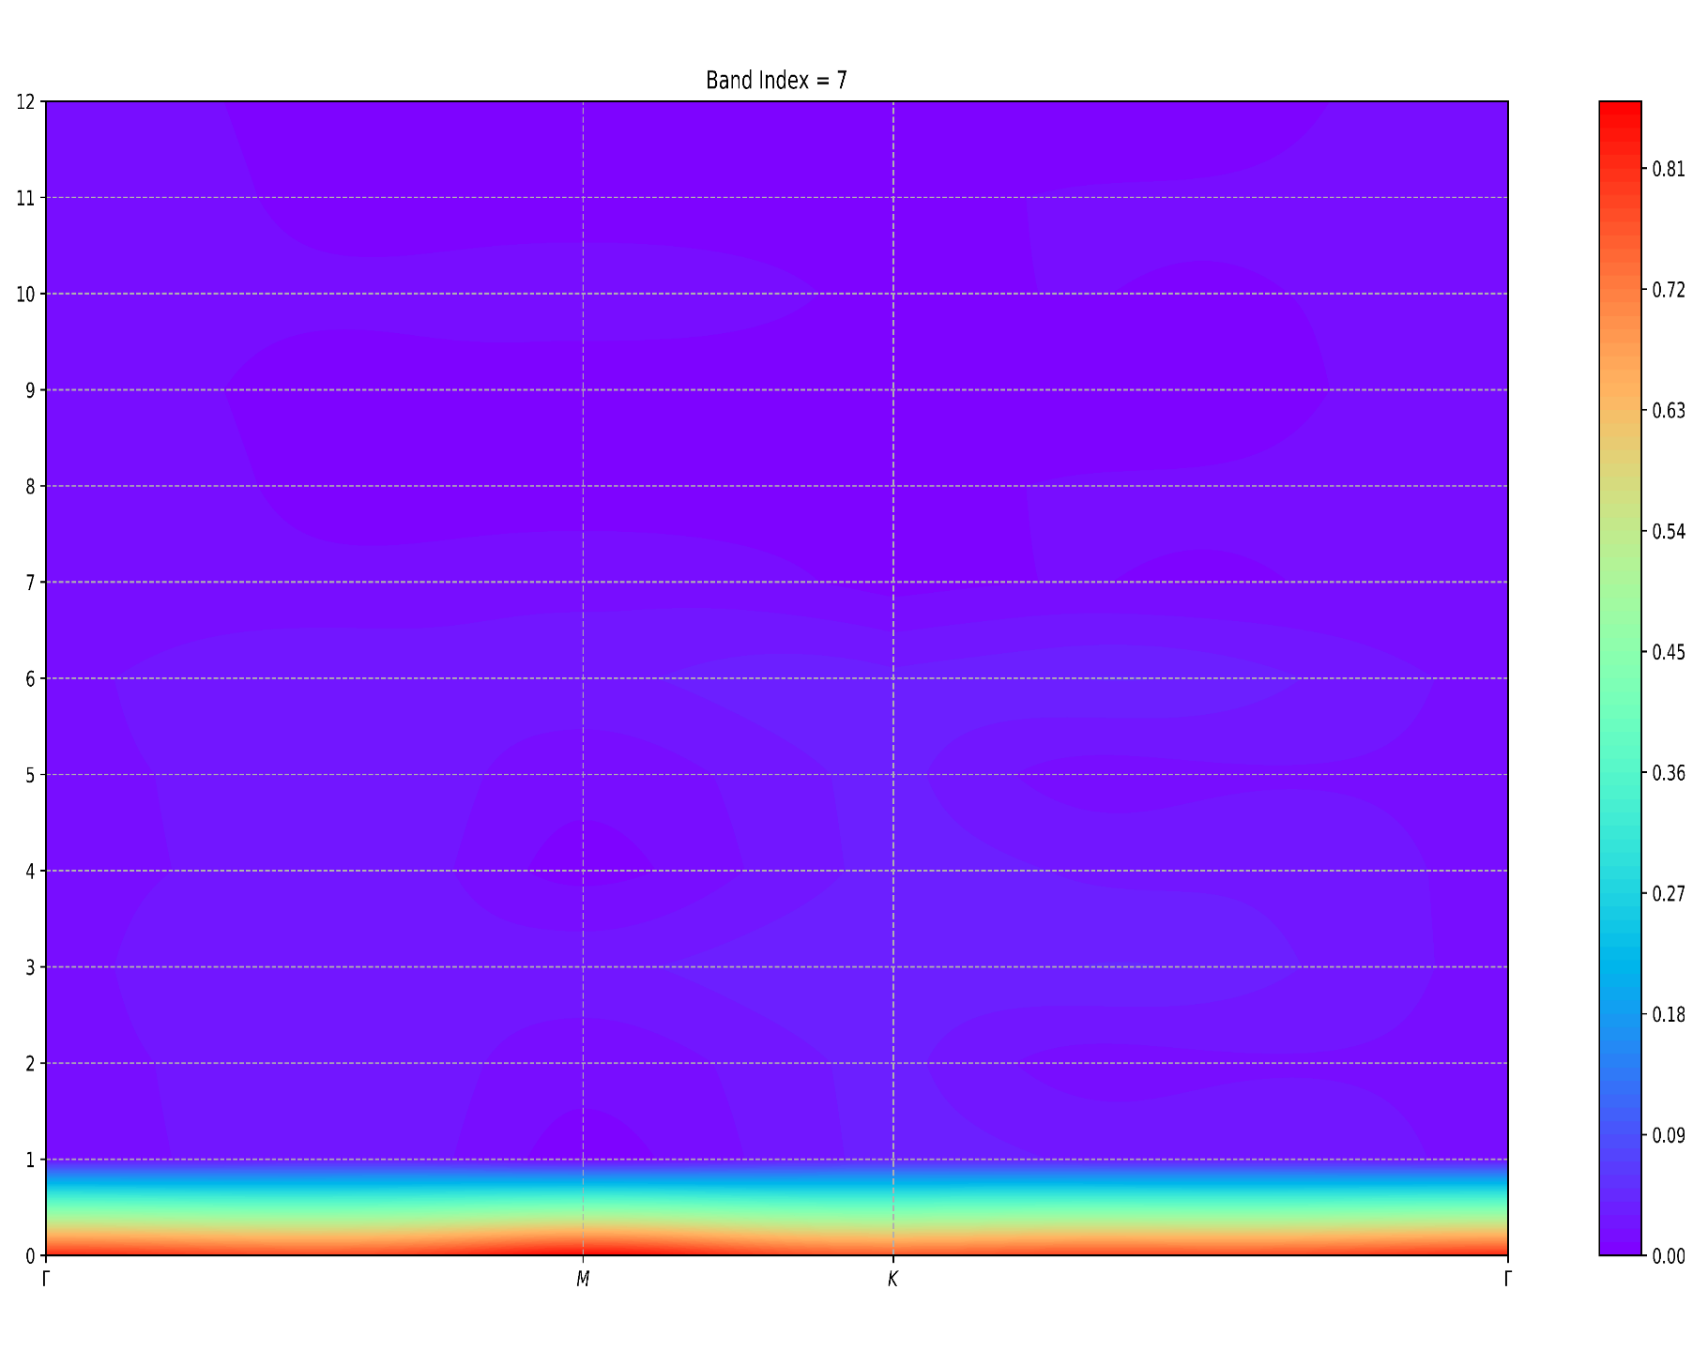
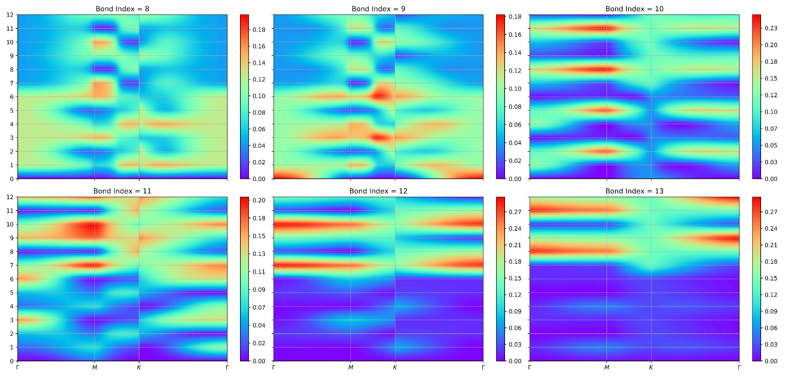

Slide 6
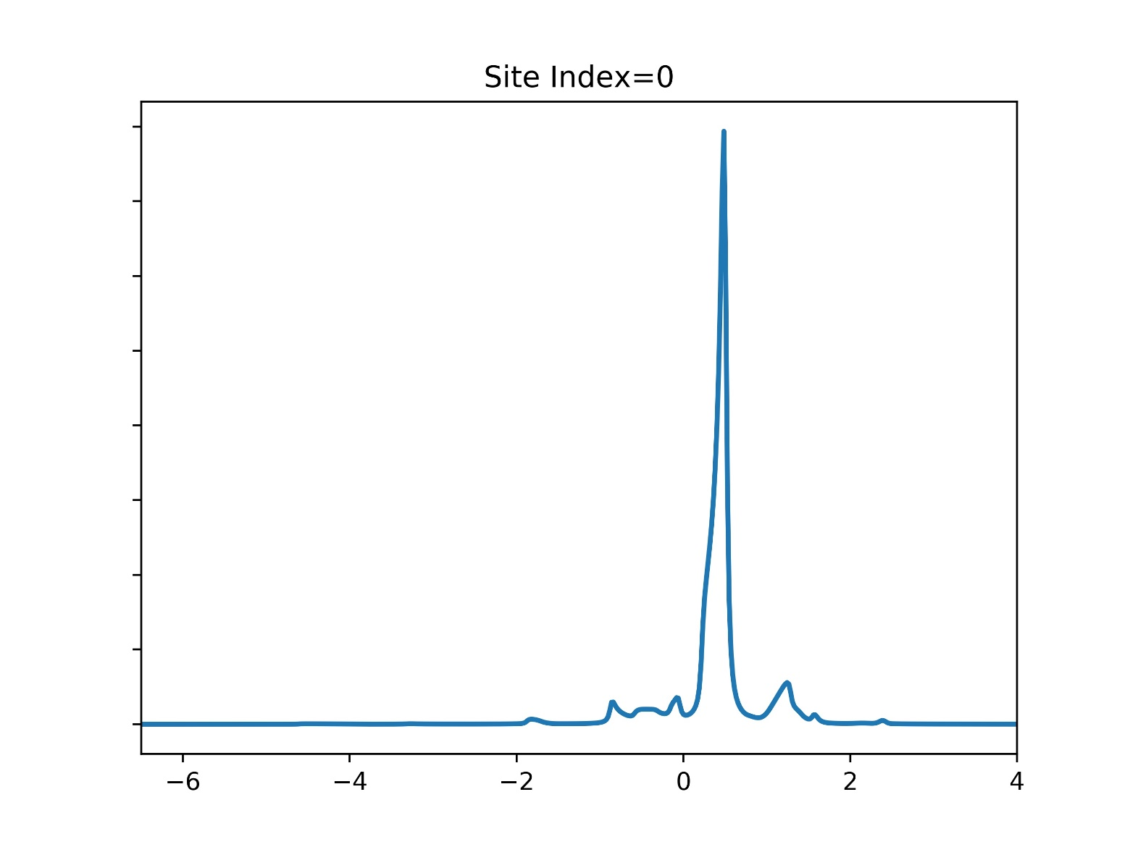
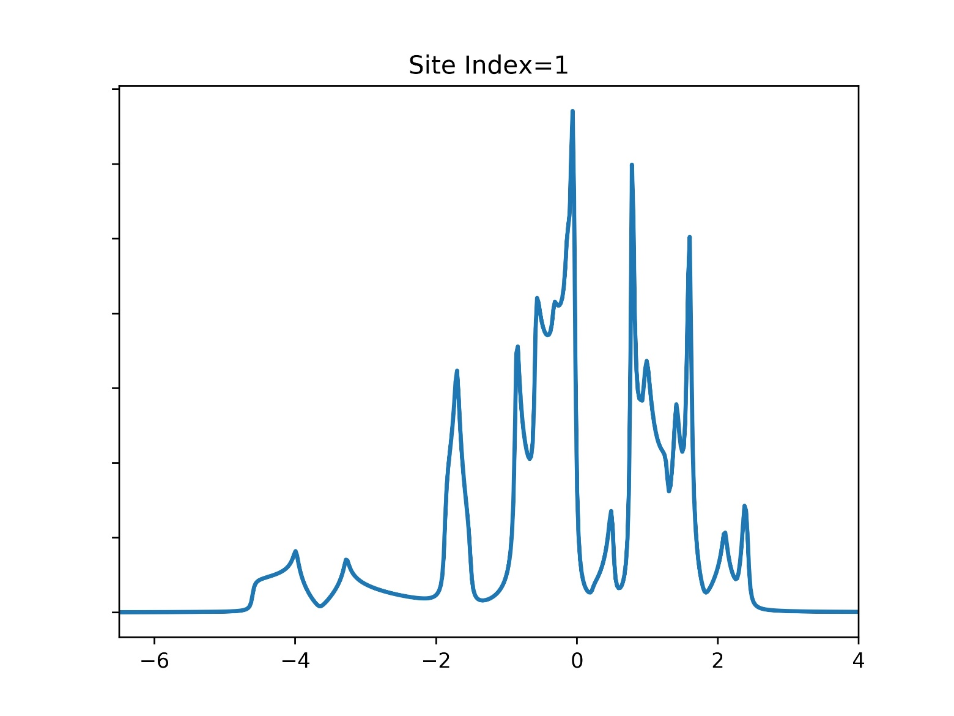
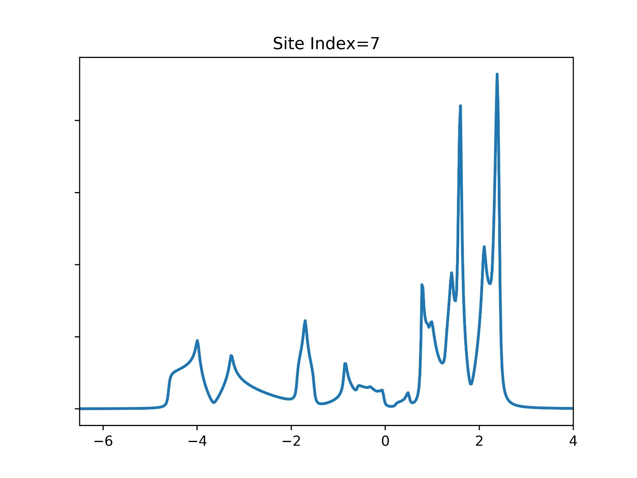

Slide 7
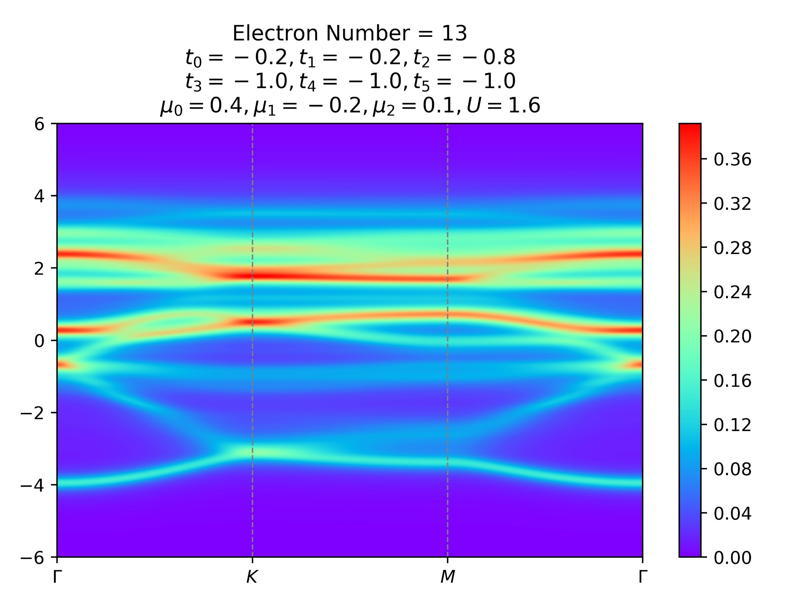


Slide 8
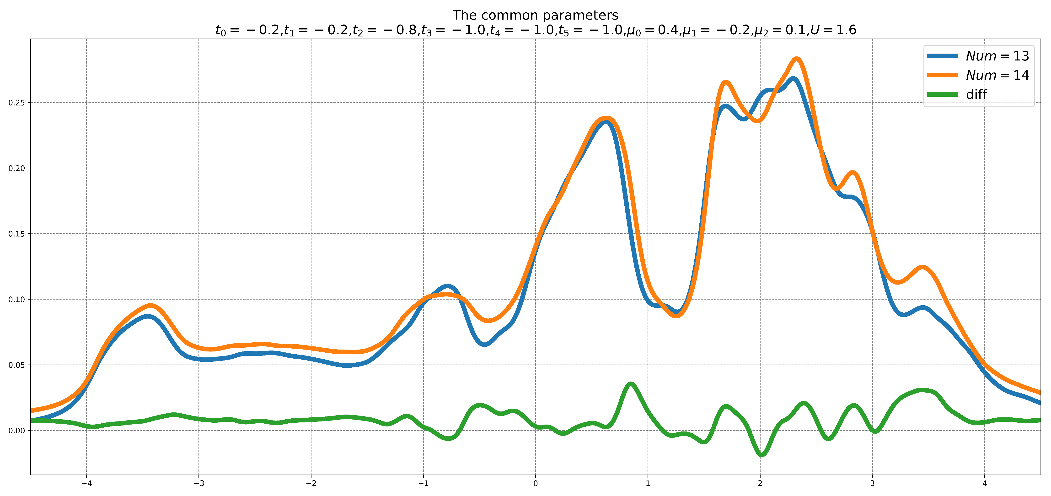

Slide 9
